Slide 1


Online direct import of specimen records from iDigBio infrastructure into taxonomic manuscripts
Lyubomir Penev , Viktor Senderov
Institute for Biodiversity and Ecosystem Research, Bulgarian Academy of Sciences, Sofia, Bulgaria & Pensoft Publishers penev@pensoft.net
Pensoft & iDigBio Webinar, 16 June 2015

Slide 2

Data deluge: We sample now more data than we can digest (analyze, publish & use)
Drawings: slavenapeneva.com

Slide 3
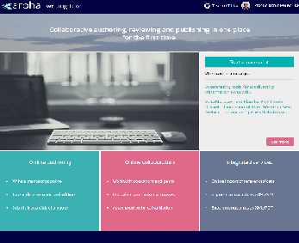
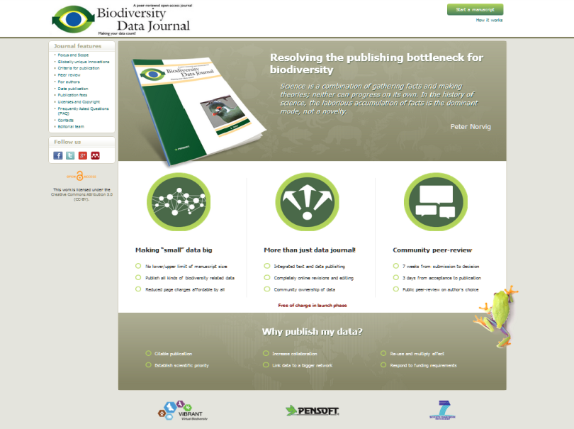
ARPHA Writing Tool & Biodiversity Data Journal facilitate data publishing & re-use
Next-Gen taxonomy requires Next-Gen publishing
+
Data import
Authoring
Peer-review
Publication
Dissemination
All within a single online collaborative platform!

Slide 4
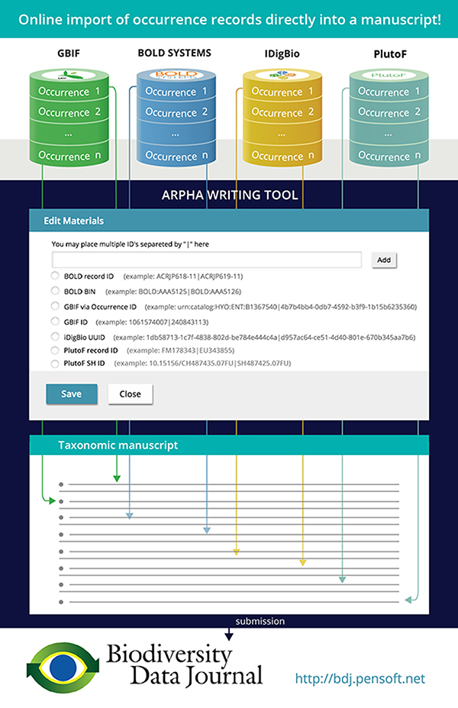

Slide 5
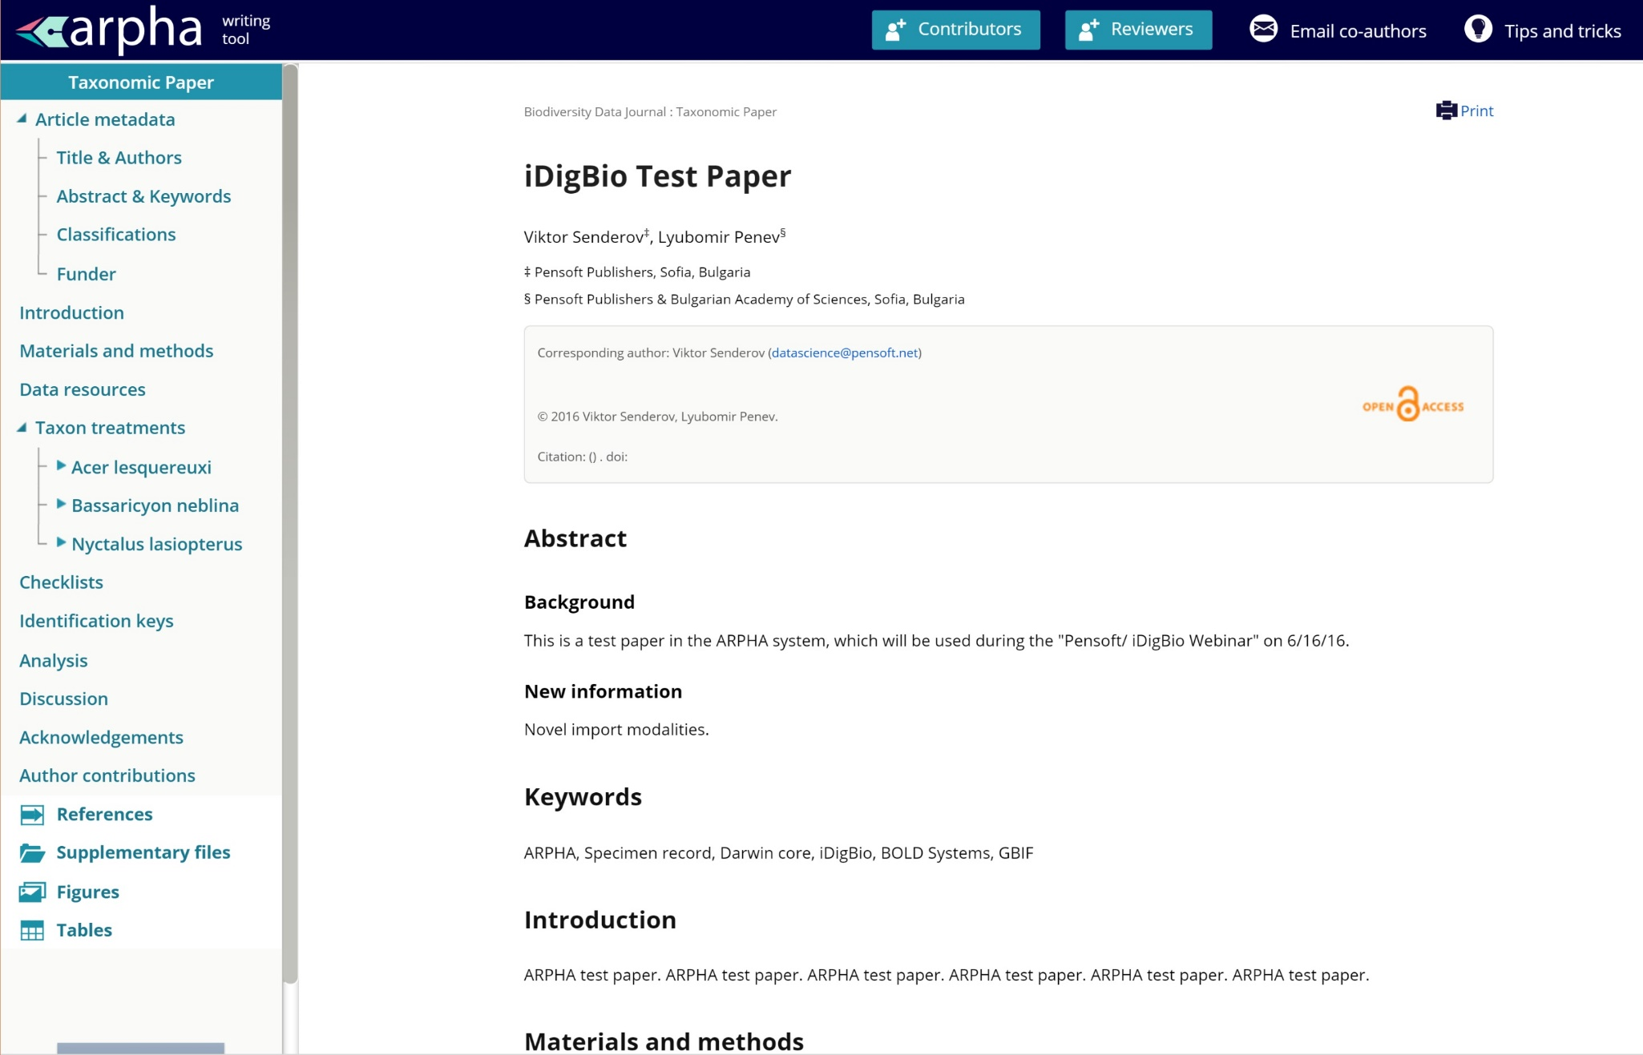
Step 1:
Step 1: Start a taxonomic manuscript in ARPHA, and open a taxon treatment

Slide 6
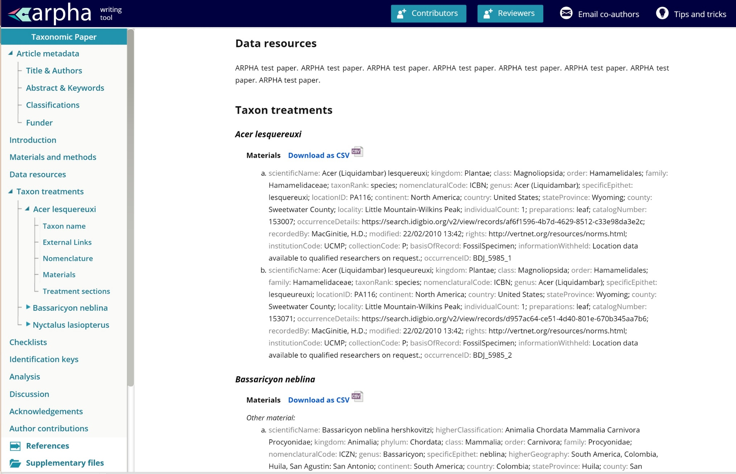
Step 1:
Step 2: Click at the Materials section within the treatment

Slide 7
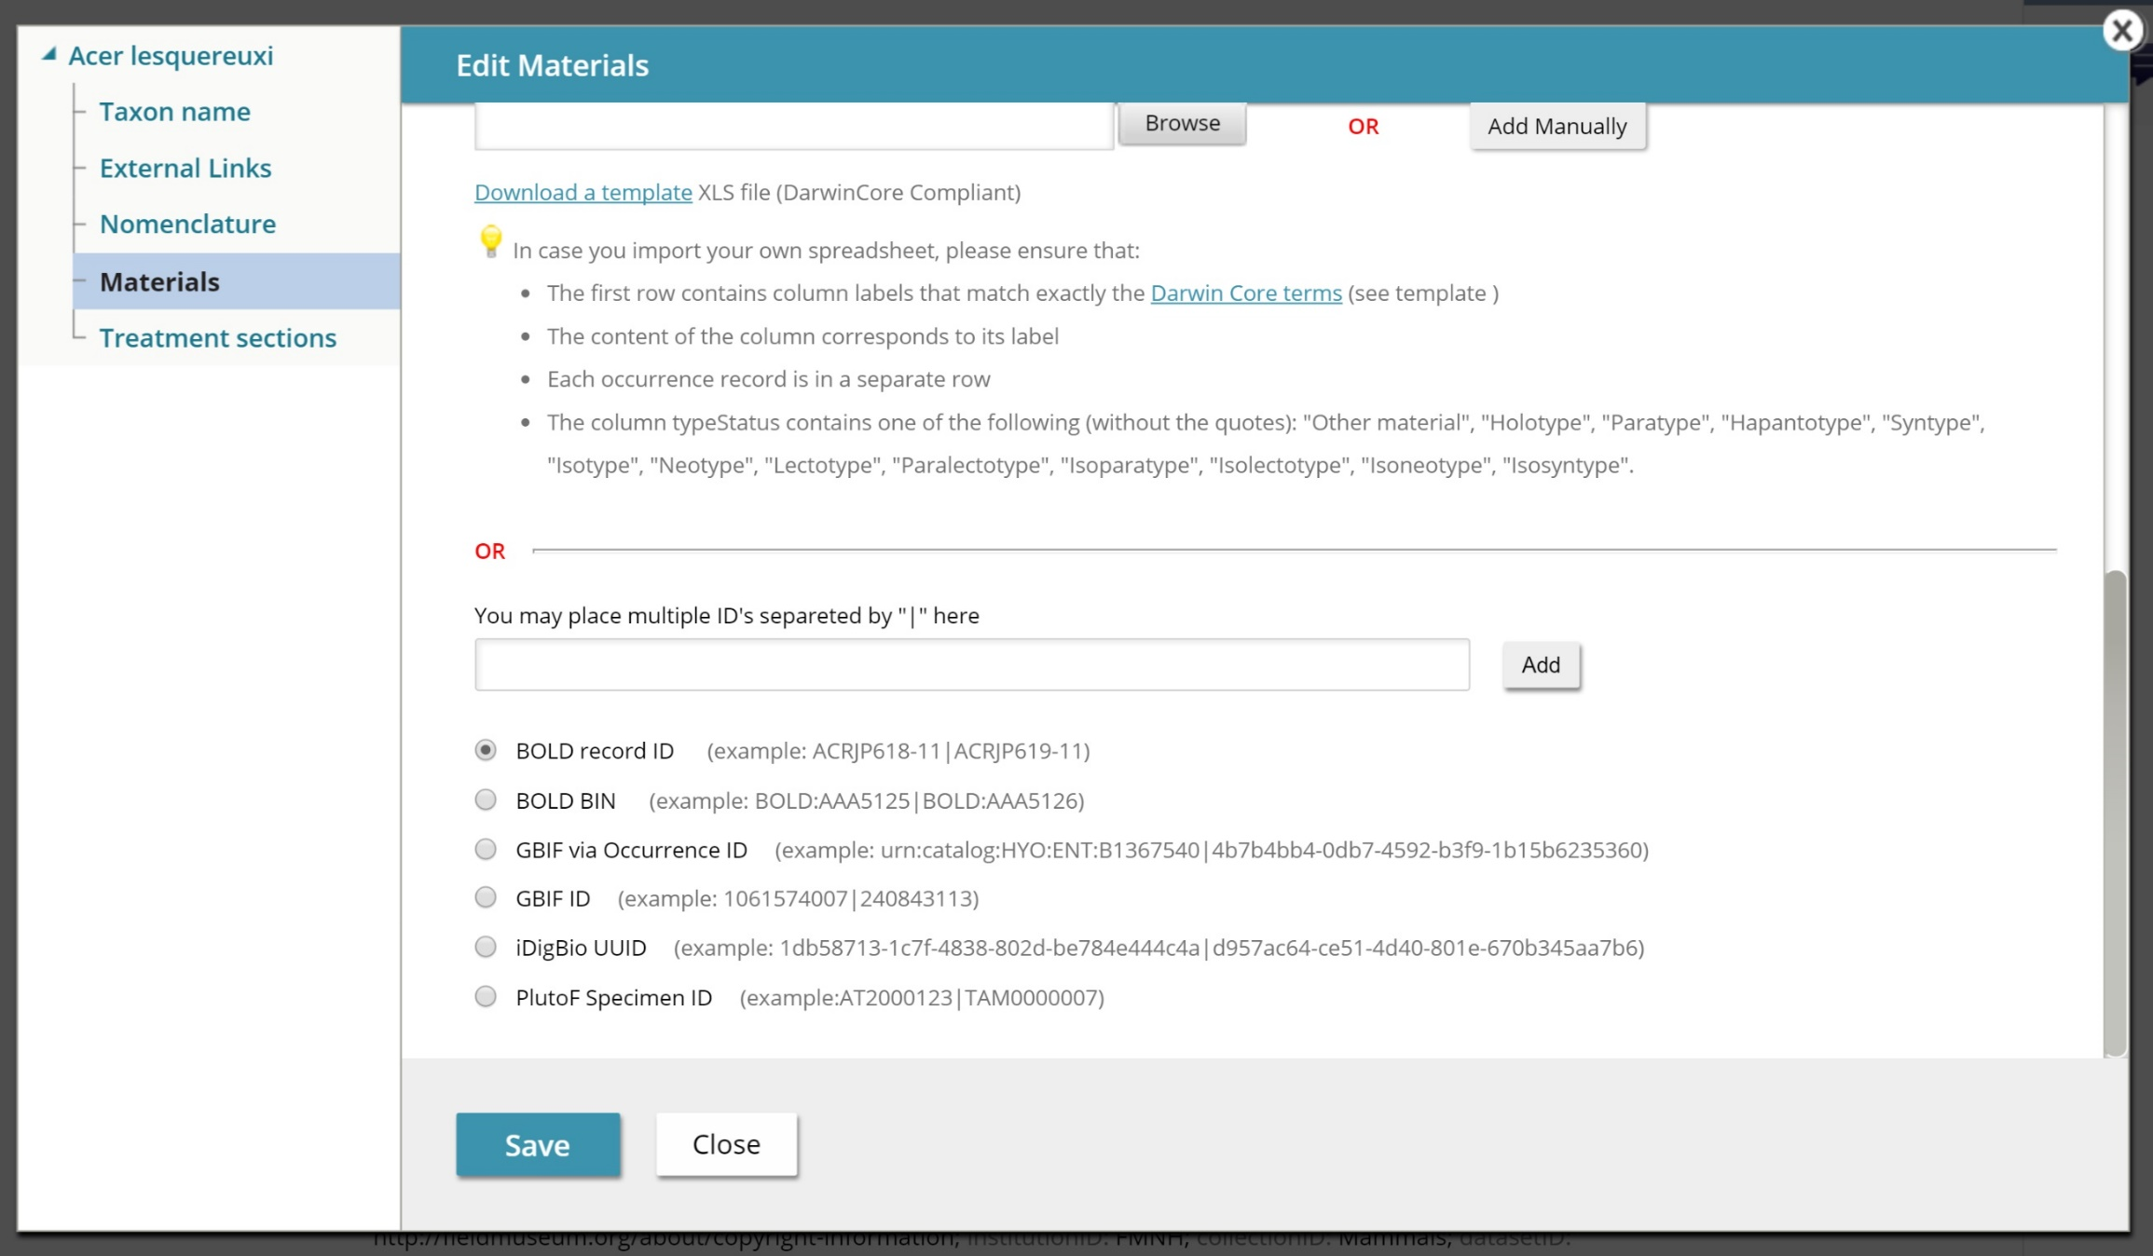
Step 2: Three ways to import specimen occurrence records into manuscript

Slide 8
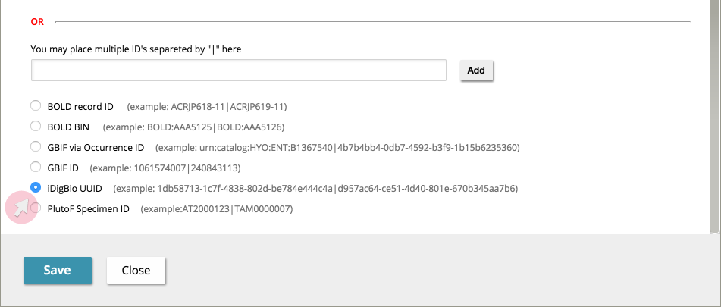
Step 3: Import from iDigBio (or GBIF, or BOLD, or PlutoF) using record ID(s)

Slide 9
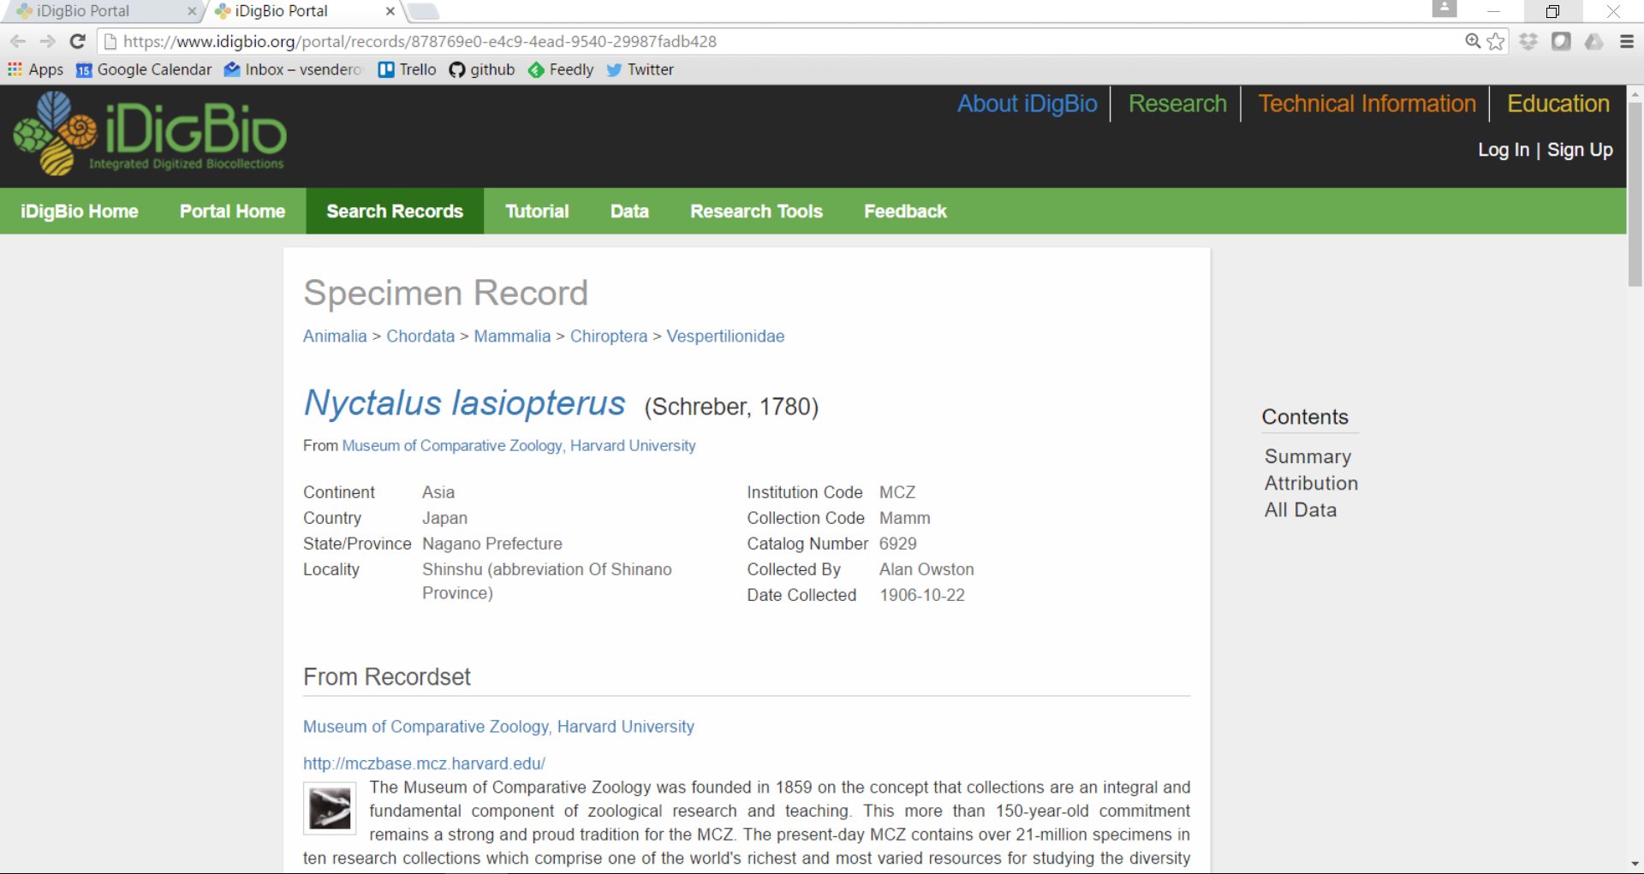
Where to take records IDs from at iDigBio?

Slide 10
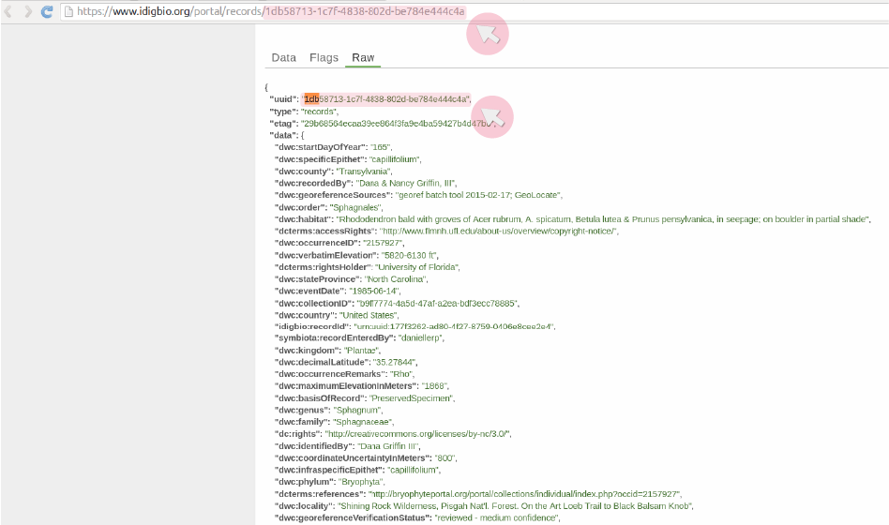
Where to take records IDs from at iDigBio?

Slide 11
WHY import specimen records in this way?
Avoid re-typing errors and save time
Tracking (provenance) information is saved in occurrenceDetails
Mobilization, peer-review and publication of small data
Data downloadable anytime as CSV file
Machine-readable and harvestable (from the XML version of the published article)
Automatically exported in Darwin Core Archive
Automatically exported to and indexed by GBIF on the day of the publication
Interoperable in DarwinCore standard
Re-usable (new opportunities for collaboration)
Increase discoverability, visibility, and citation of authors’ work

Slide 12
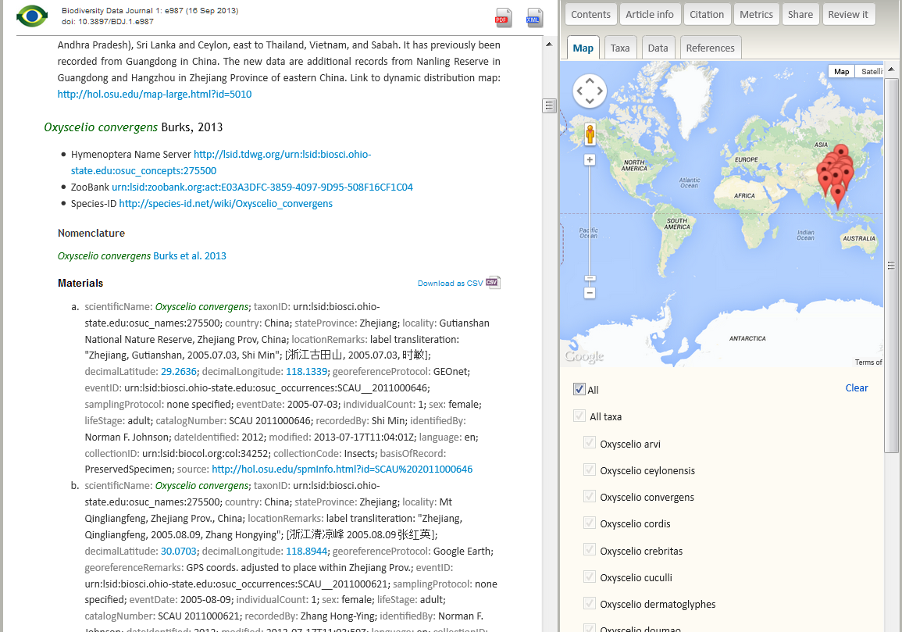
This how data look like in the published paper

Slide 13
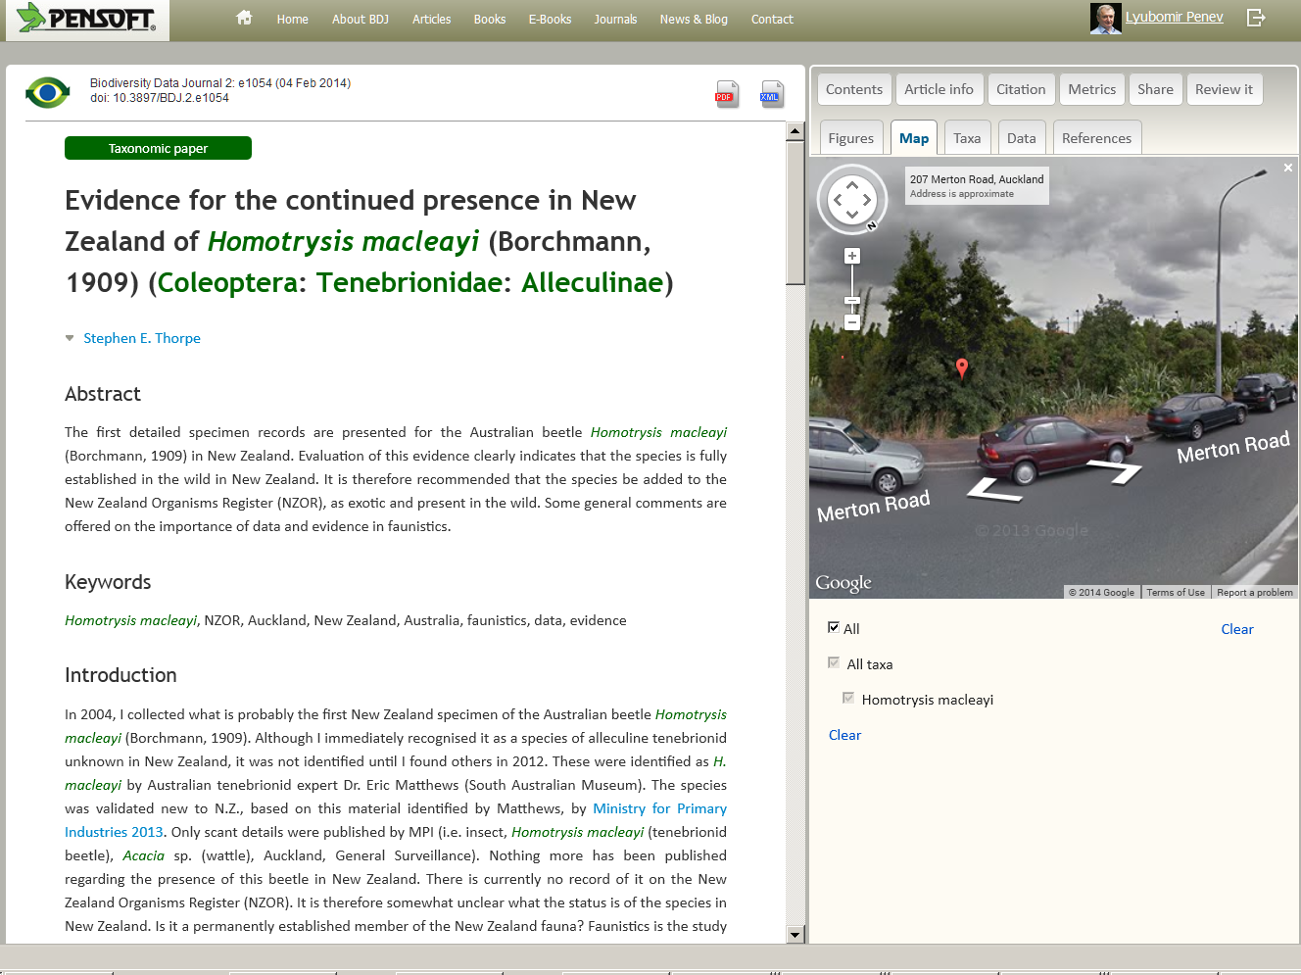
Mapping and better visualization

Slide 14
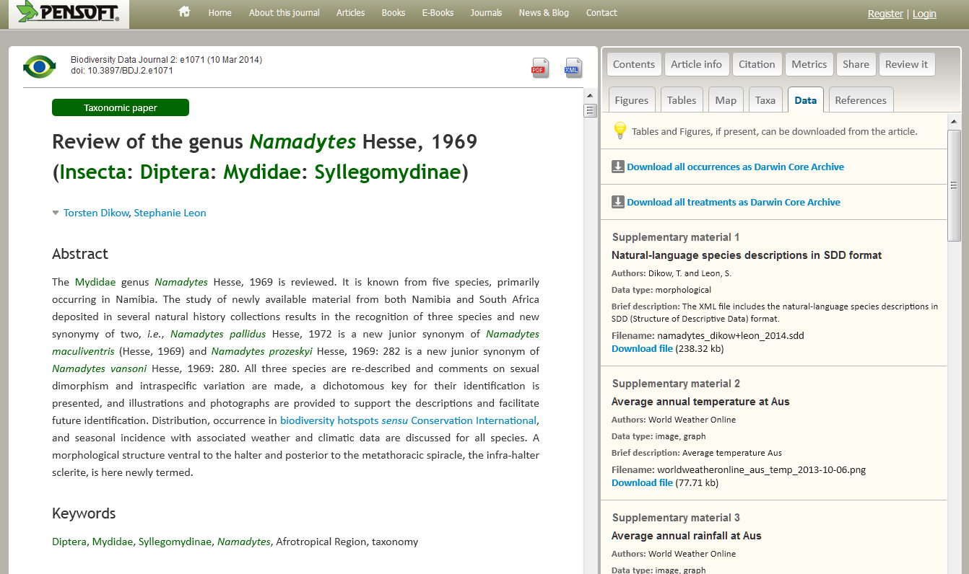


Easy export, harvesting & re-use

Slide 15
Live demo
Data : https://docs.google.com/spreadsheets/d/1dpzq54F9LmjQZG9Ljuh5-V3shRBaQOnql5HHqSs1mYQ/edit?usp=sharing
Open “iDigBio Test Paper”
Import specimens for Acer lesquerexi (some sort of prehistoric plant) – just click on most recent things
Import specimens for Bassaricyon neblina (raccoon-like mammal)
Import specimens for Nyctalus lasiopterus (a bat species)
Show how to delete materials, import bulk with “|”, import from BOLD BIN

Slide 16
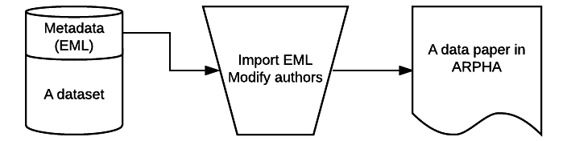

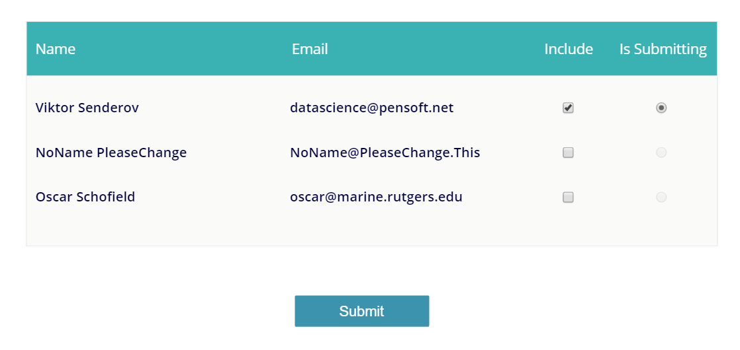
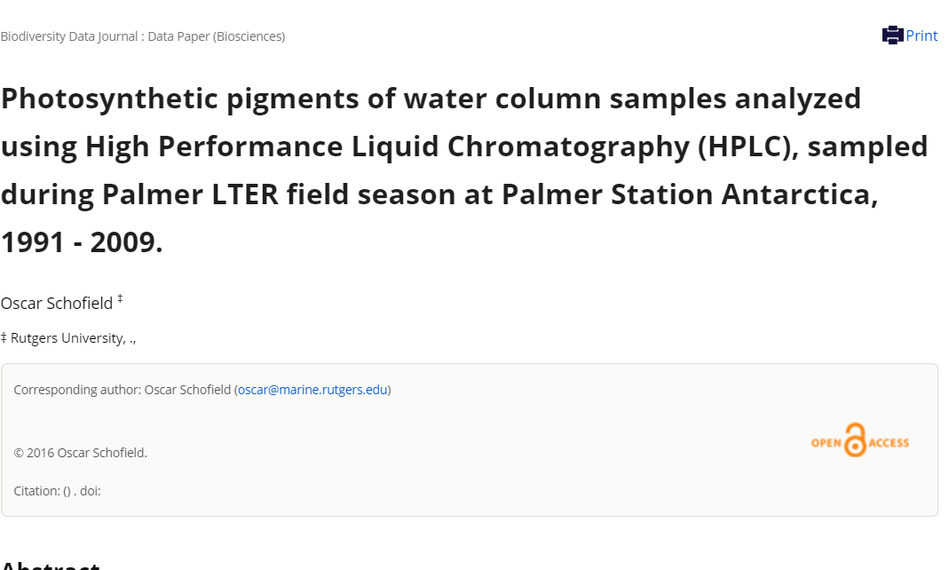


Can we generate and import an entire manuscript?

Slide 17
Live demo
https://search.dataone.org/#view/https://pasta.lternet.edu/package/metadata/eml/knb-lter-pal/130/2
Photosynthetic pigments of water column samples analyzed using High Performance Liquid Chromatography (HPLC), sampled during Palmer LTER field season at Palmer Station Antarctica, 1991 - 2009.. U.S. LTER Network.

Slide 18
For developers and data managers: Pensoft API
http://arpha.pensoft.net/dev/
Allows to import different types of papers as XML. E.g.:
Software Description
Taxonomic Paper
Data paper
For collaborations please contact us at info@pensoft.net

Slide 19
Our sincere thanks are due to
Pensoft developers team
European Commission: EUBON FP7 Project
European Commission: PhD Financed through the EU Marie-Sklodovska-Curie Program Grant Agreement Nr. 642241
Slavena Peneva (drawings and design)

Slide 20



I Open Science!
PLAZI

